Slide 1

Impact of Coding in Automobiles

Slide 2
Table of content
INTRODUCTION
OBJECTIVE
OVERVIEW
FRAMEWORK
CHALLENGES
CONCLUSION
REFERENCE

Slide 3
INTRODUCTION
Coding has transformed automobiles from mechanical systems into software-defined vehicles with over 100 million lines of code per car, enabling features like ADAS, infotainment, and OTA updates. This study highlights its importance for safety, efficiency, and innovation amid electrification and autonomy trends. The context focuses on a real-world case of AUTOSAR software integration in powertrain for autonomous vehicles.

Slide 4
Objectives of the Study
To examine coding's role in automotive
embedded systems and real-time control.
2. To analyze a case study on AUTOSAR
stack integration for powertrain and
BMS.
​
3. To identify key challenges in
automotive software development.
​
4. To evaluate technology stacks and
their impact on vehicle performance.
​
5. To recommend strategies for
overcoming coding hurdles in autos.

Slide 5
Case Study Overview
This case involves a leading Tier-1 supplier partnering with Acsia Technologies for a global OEM's autonomous driving project.
Location: Global automotive supply chain, with development likely in India/Asia-Pacific.
Duration: 2023 project timeline, meeting production deadlines.
Stakeholders: Tier-1 supplier, OEM, Acsia team handling AUTOSAR config, integration, testing, and FuSa.

Slide 6
Technical Framework / Architecture
System architecture centers on AUTOSAR stack for powertrain BMS, integrating Vector Boot Loader, OEM app SW, UDS diagnostics, and OBD services; tested on HIL with ASPICE V-model.
Technology stack: C/C++, AUTOSAR Adaptive, Vector tools (DaVinci Configurator, VTestStudio, MATLAB/Simulink for simulation.
Tools: QNX RTOS, ROS 2 middleware, Jenkins CI/CD; diagram
description: ECU layers (BSW, RTE, App) connected via CAN/Ethernet.

Slide 7
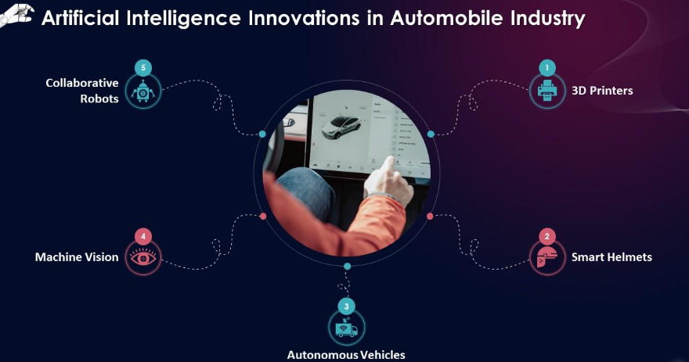
Challenges Identified
Key issues include siloed hardware-software development causing integration bugs and delays. Cybersecurity risks from connectivity and OTA updates, plus legacy system compatibility. Compliance with ISO 26262 safety and scalability for millions of vehicles; real-time constraints in ADAS/autonomy.

Slide 8
Conclusion
Problem: Complex software integration for autonomous powertrain amid tight deadlines and standards.
Key findings: Coding enables EV efficiency, ADAS safety, but faces scalability/cyber
Challenges: AUTOSAR met deadlines, boosted satisfaction.
Recommendation: Adopt hybrid AI-optimized C/C++ workflows, AUTOSAR, and secure SDLC for reliable SDVs.

Slide 9
References
Journals/Research: ISO 26262, AUTOSAR standards docs.
​
Research papers: Apriorit on automotive trends (2024).
​
Websites: Acsia Technologies case study; Apriorit blog [page:0, wait full]; Ampheo embedded systems.

Slide 10
Thank You
Thank you for your attention!
Q&A?

